Slide 1
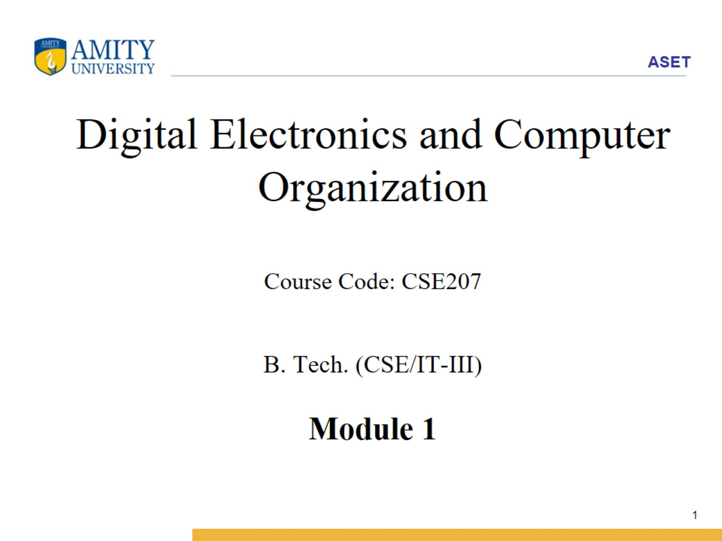
Digital Electronics and Computer Organization Course Code: CSE207 B. Tech. (CSE/IT-III) Module 1

Slide 2
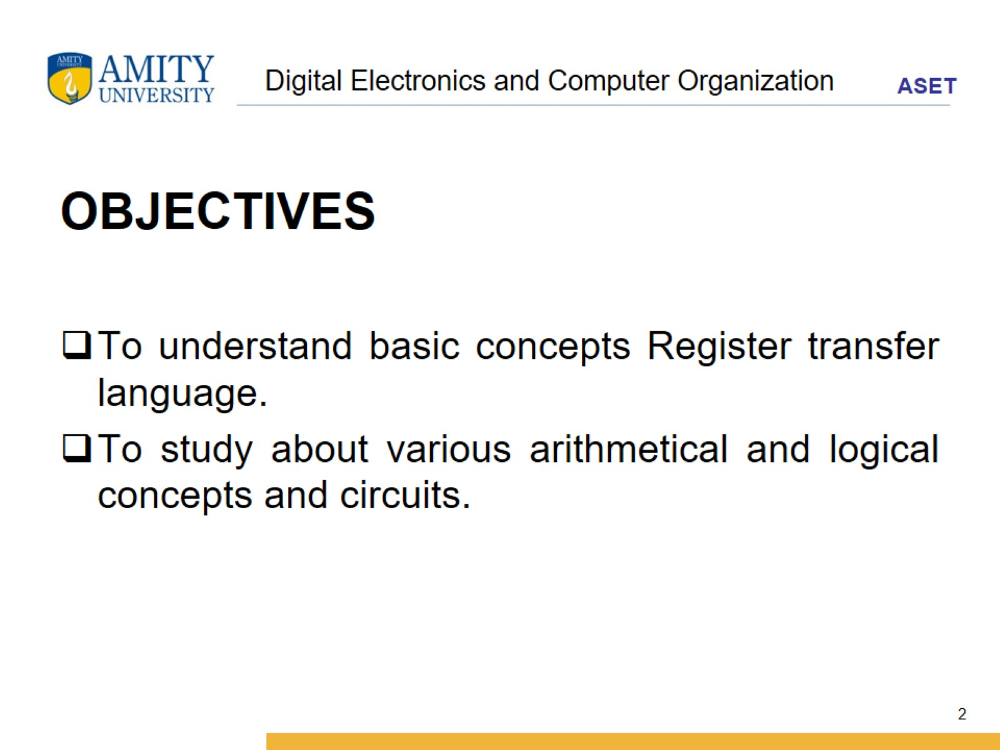
Digital Electronics and Computer Organization

Slide 3
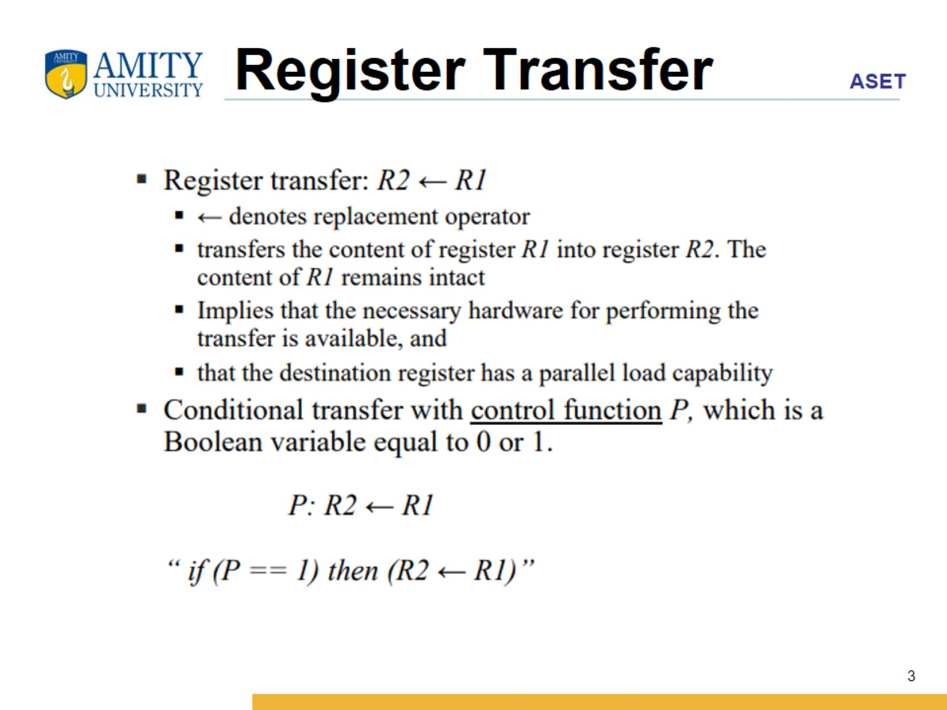
Register Transfer

Slide 4
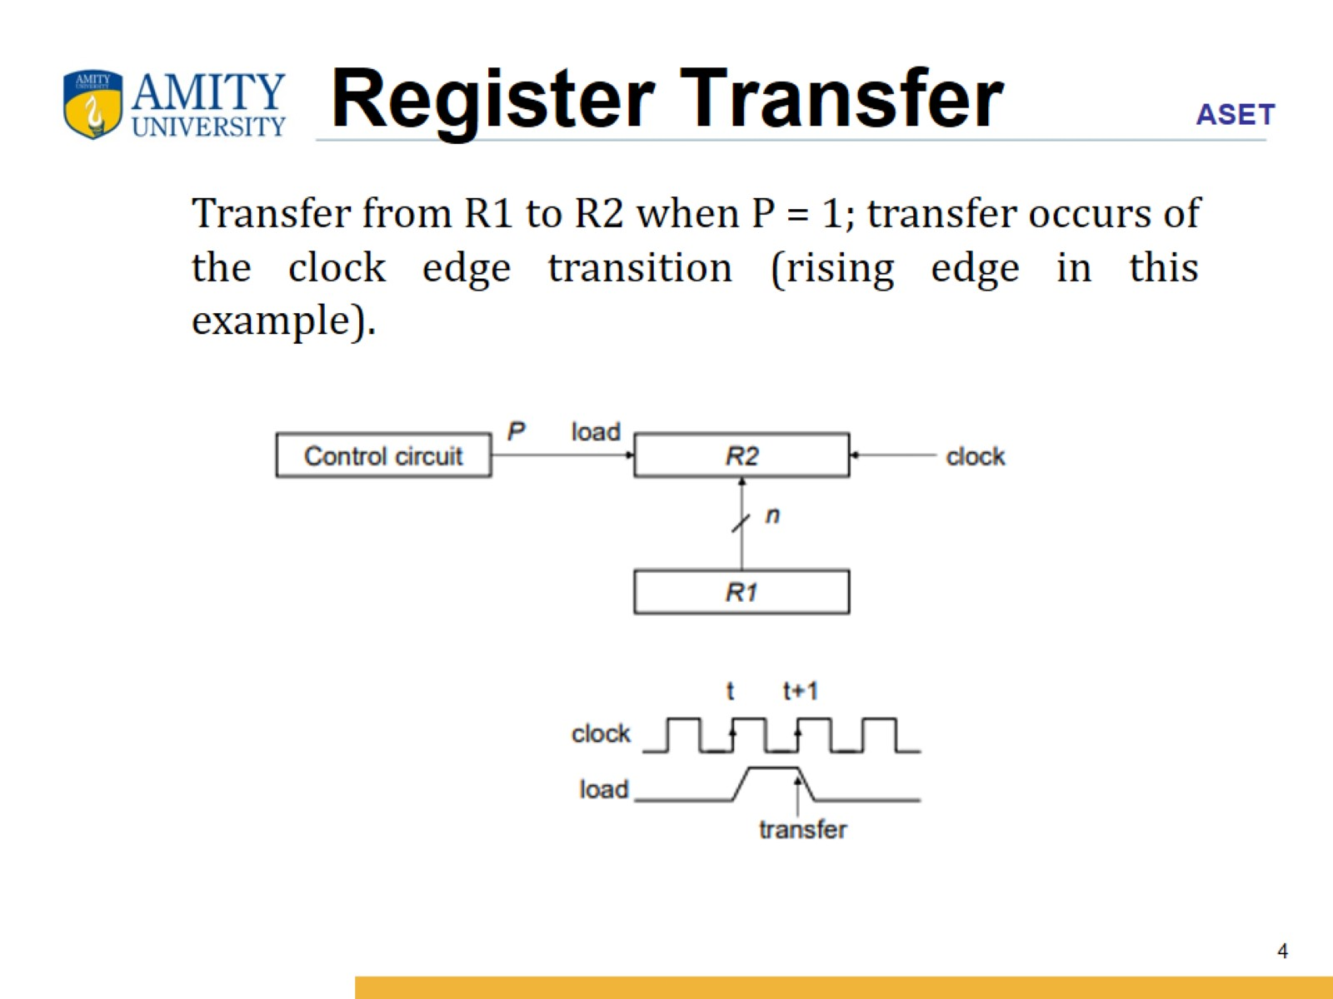
Register Transfer

Slide 5
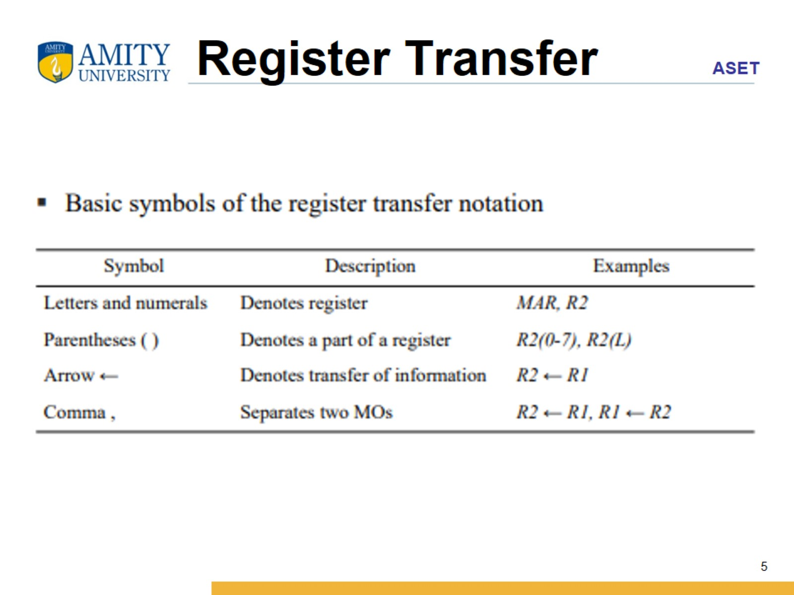
Register Transfer

Slide 6
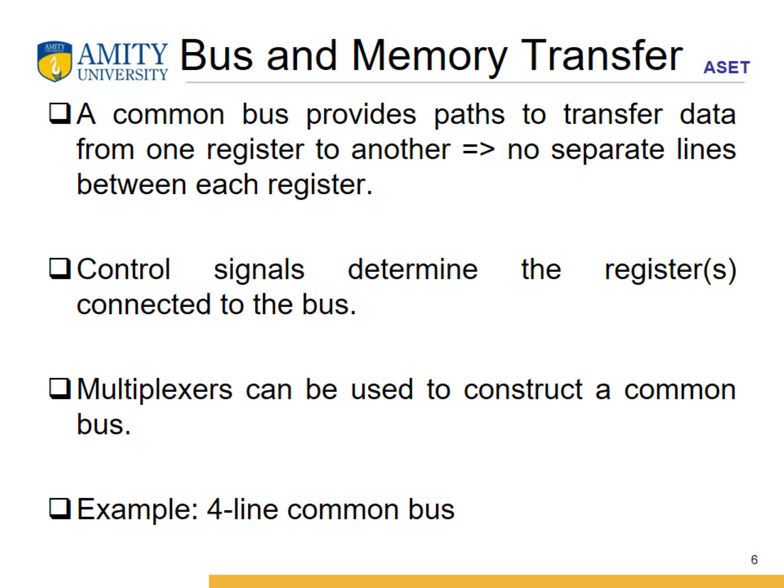
Bus and Memory Transfer

Slide 7
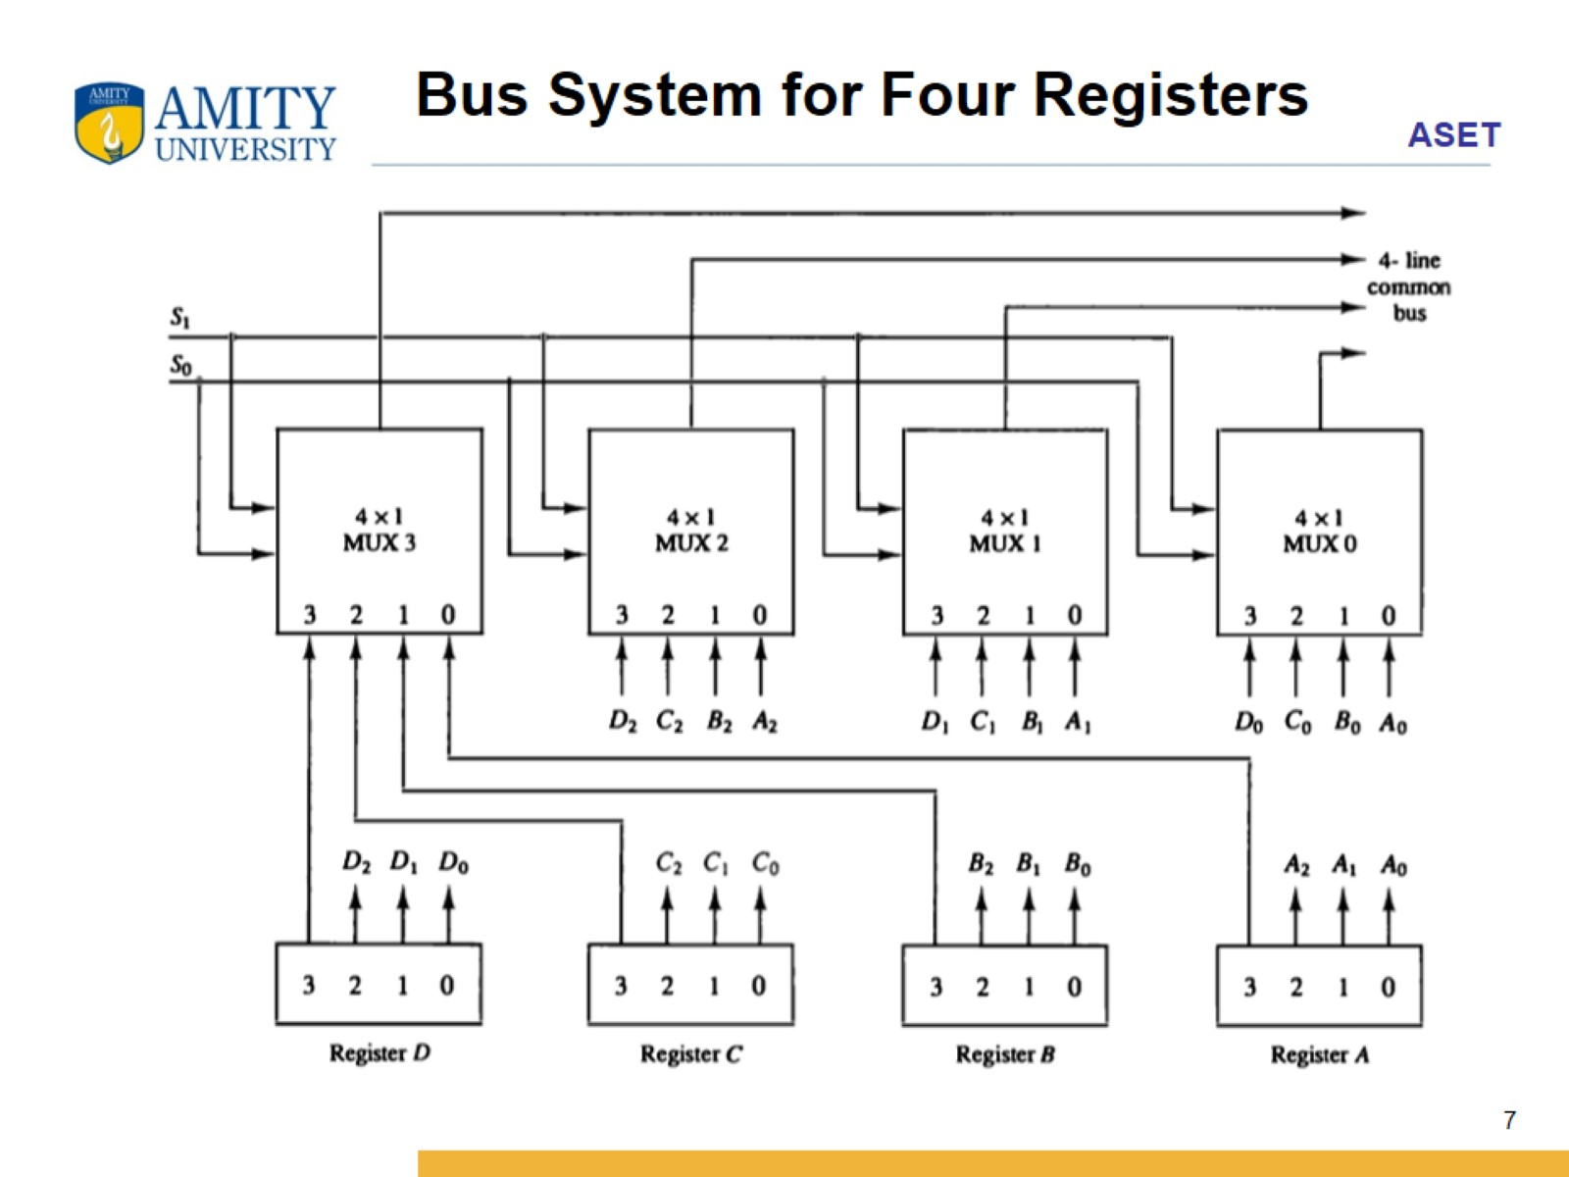

Slide 8
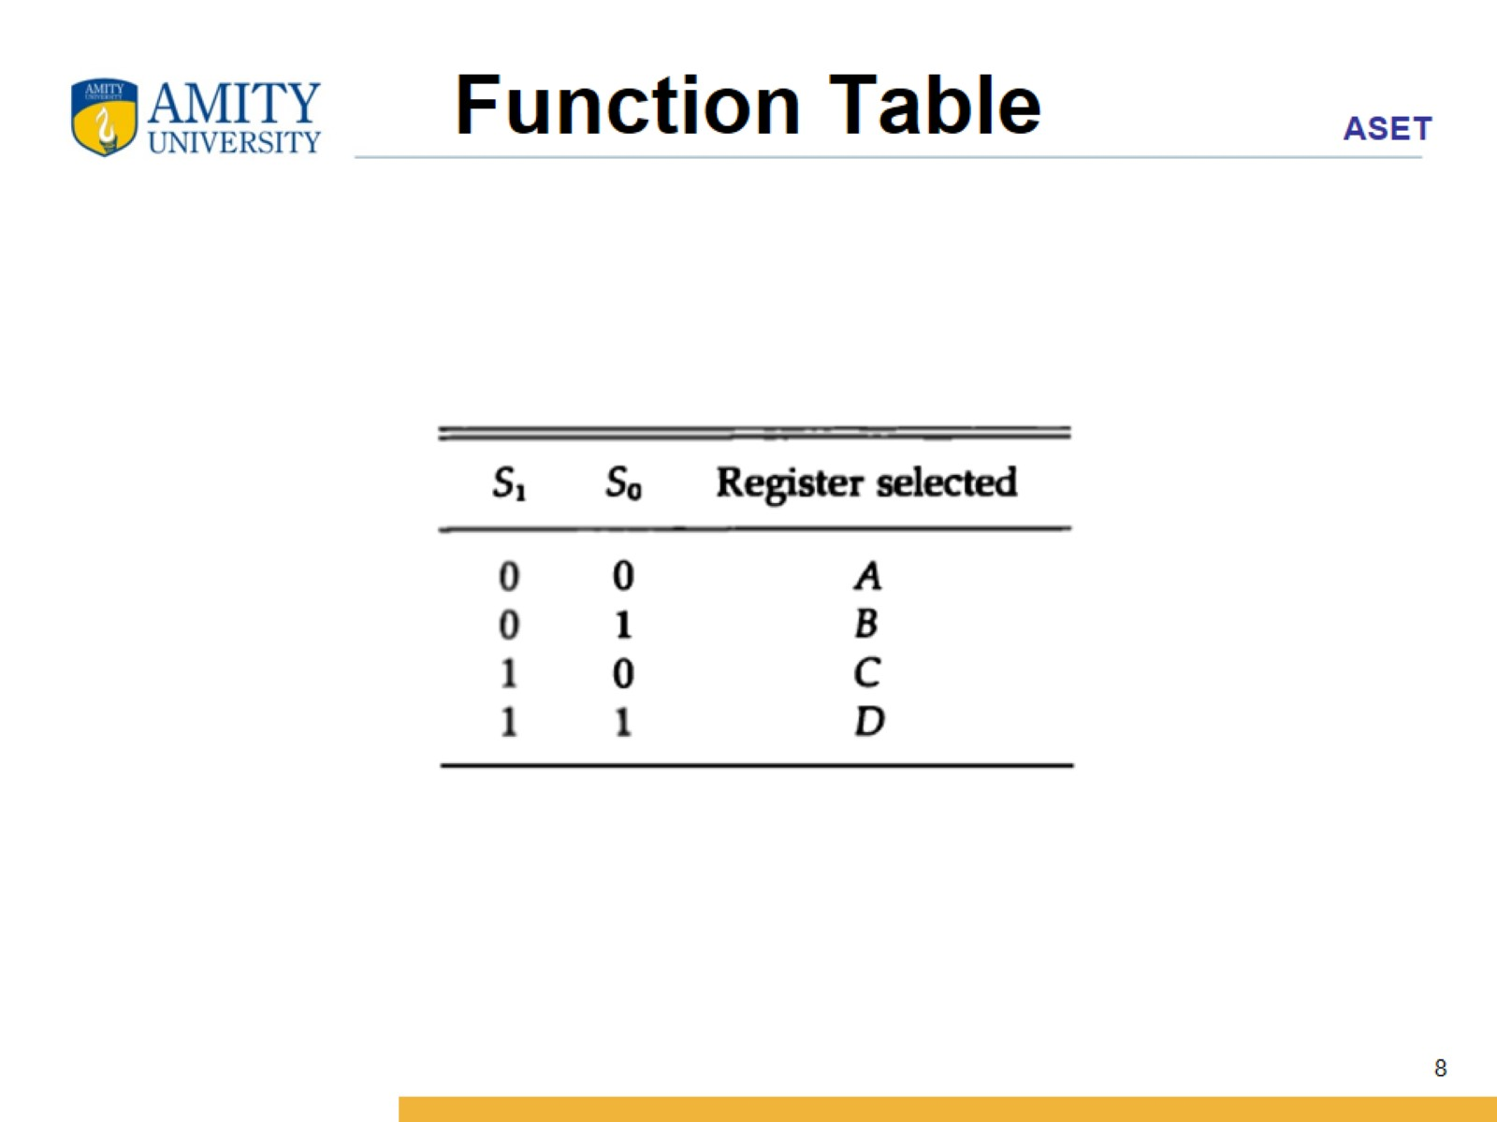
Function Table

Slide 9
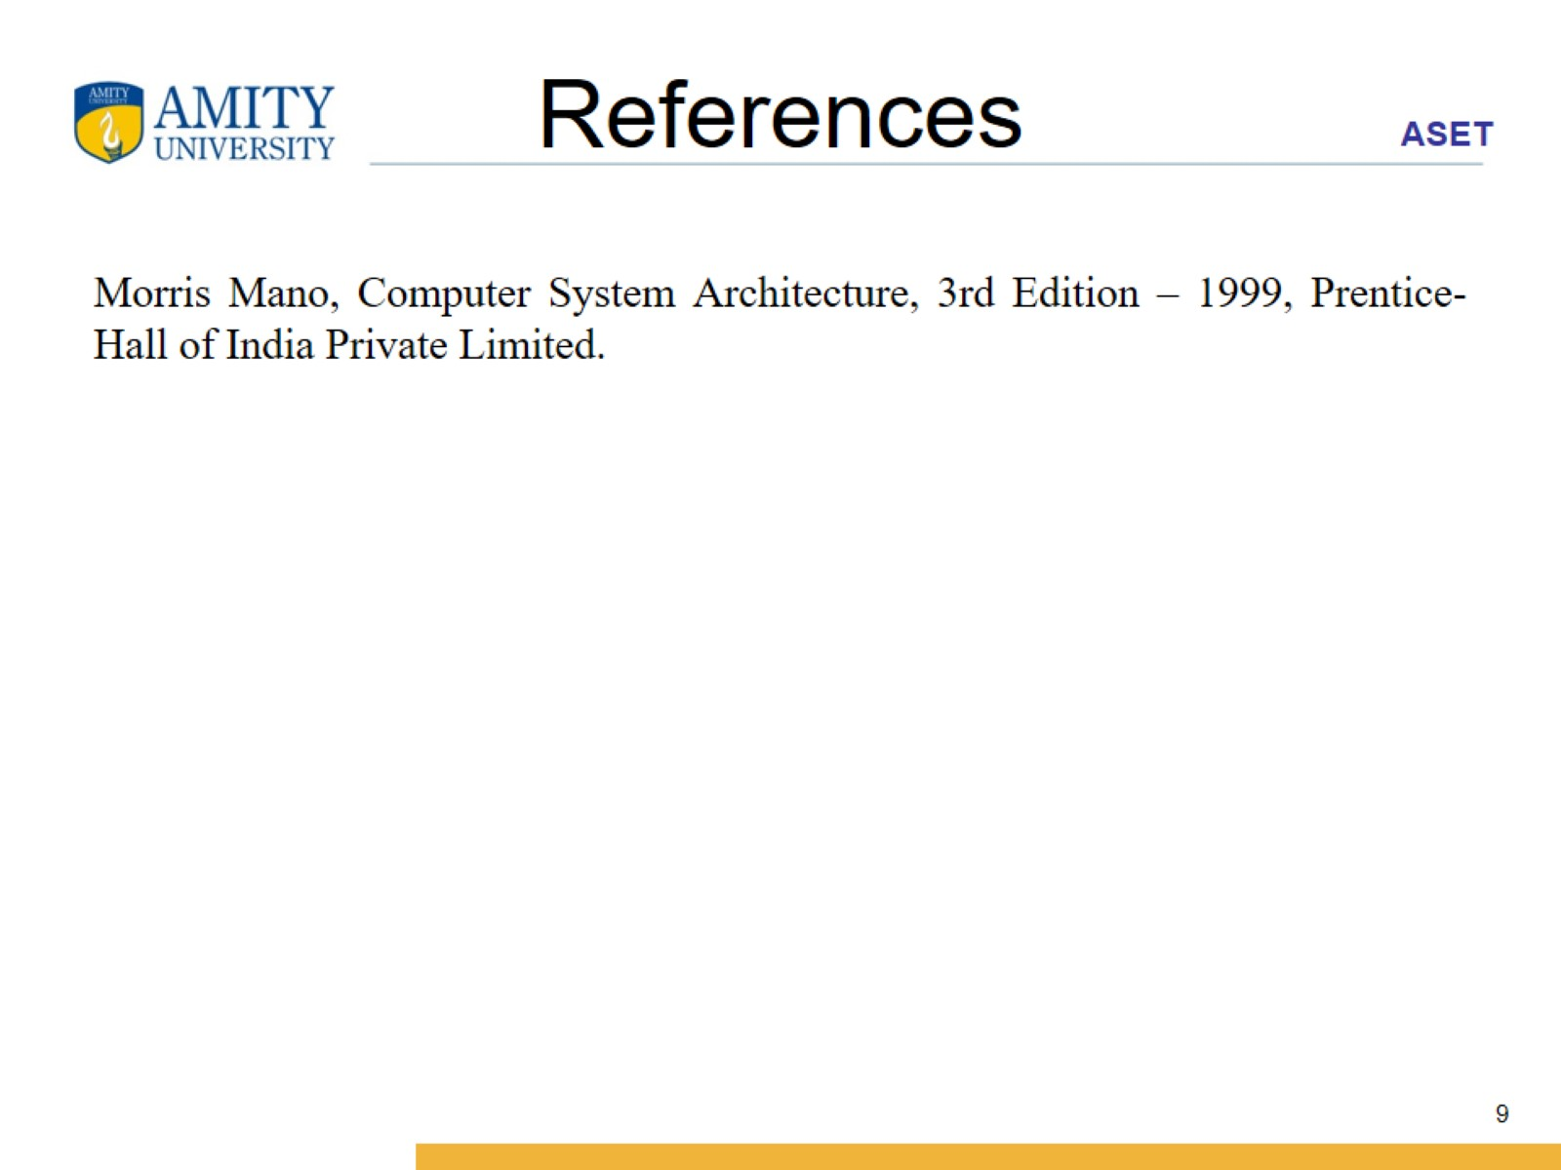
References

